Slide 1

Starter Task
Sign into Glow then open Teams
View your assignment feedback from
Some of you may need to change your answers and re-submit

Slide 2
Learning intentions and success criteria
I am learning…
I can…
About different photography genres
How to describe photography genres
Identify and define different photography genres
Create a presentation about different photography genres

Slide 3

Photography Genres
NPA Digital Media

Slide 4
Introduction
Whatever your interests, there is a genre and style of photography for you:
Genres are the broad categories that classify photographs
What subject are you capturing?
Styles are the unique visual approaches within those genres
How are you capturing that subject?
Today we will go over a few popular genres of photography.
All the examples are photos by me!

Slide 5

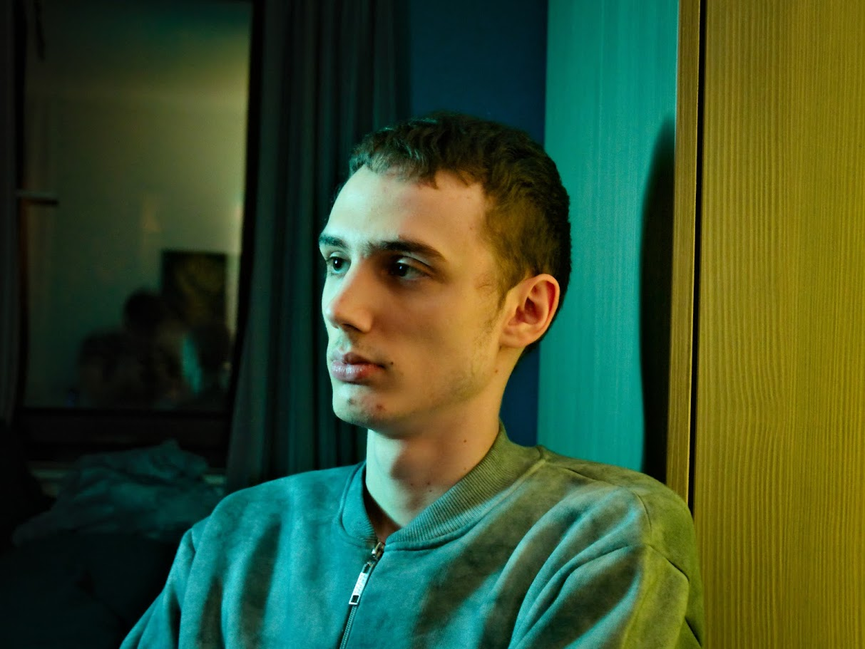
Portrait Photography
Focuses on capturing the personality and emotions of individuals or groups.

Slide 6
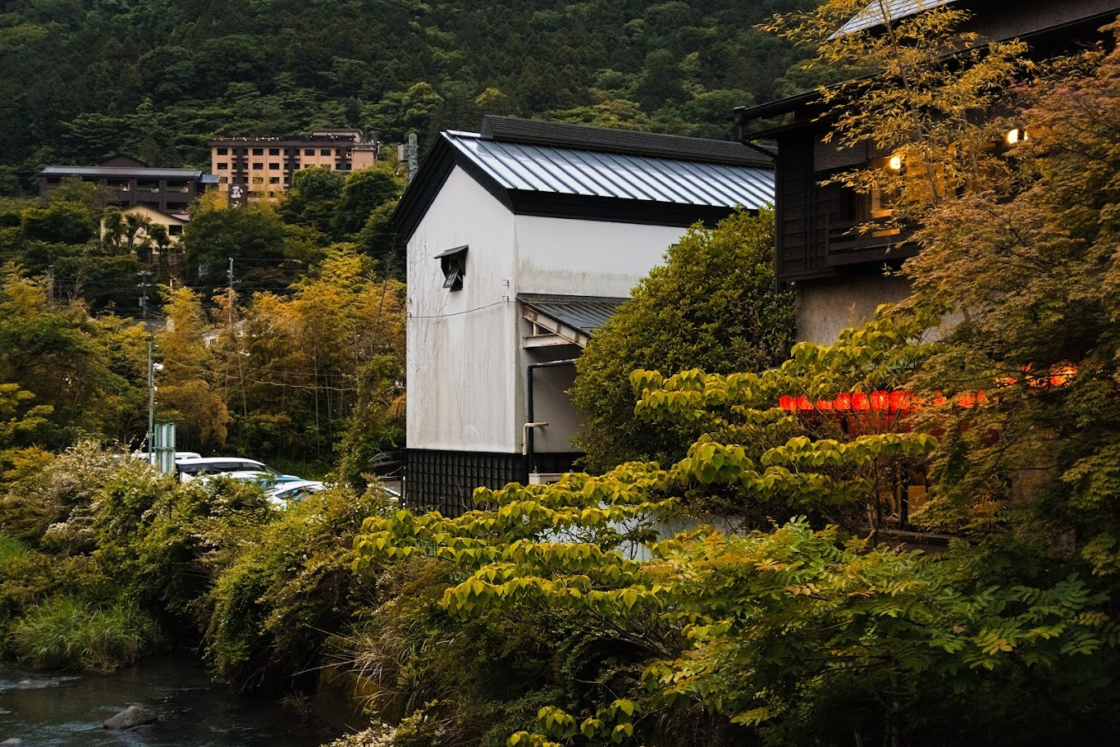
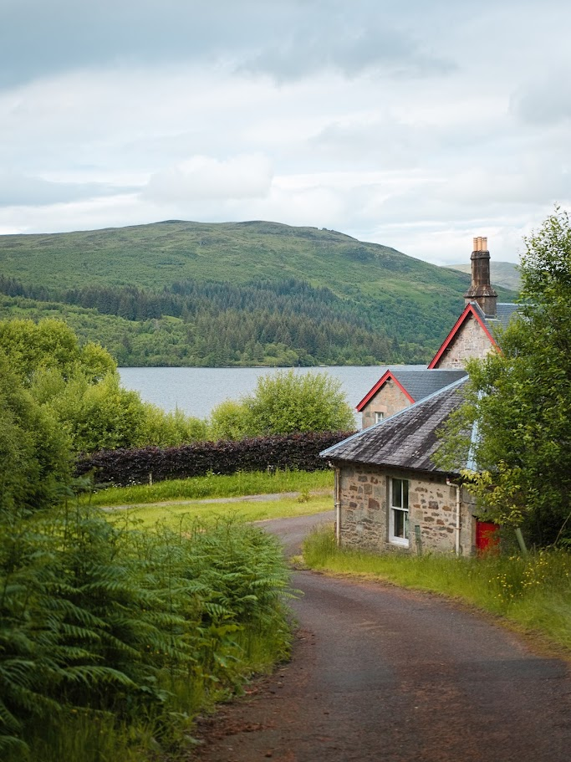
Landscape Photography
Emphasizes the beauty of natural scenes, often showcasing expansive vistas.

Slide 7
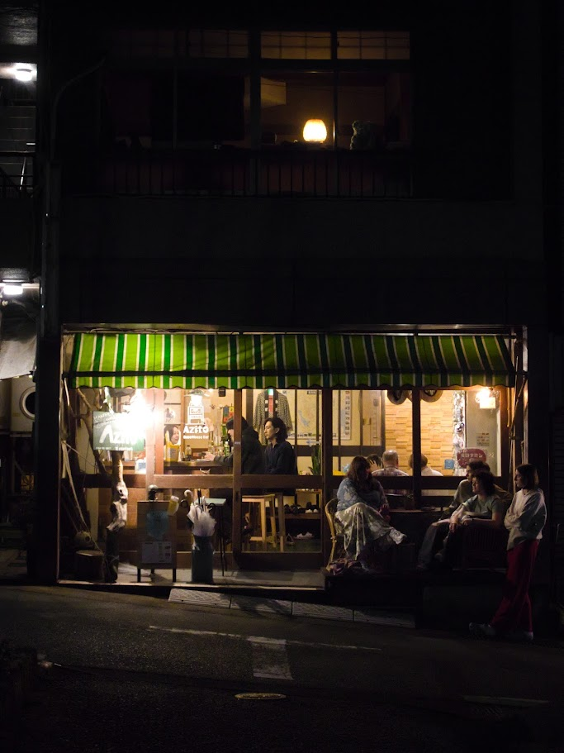

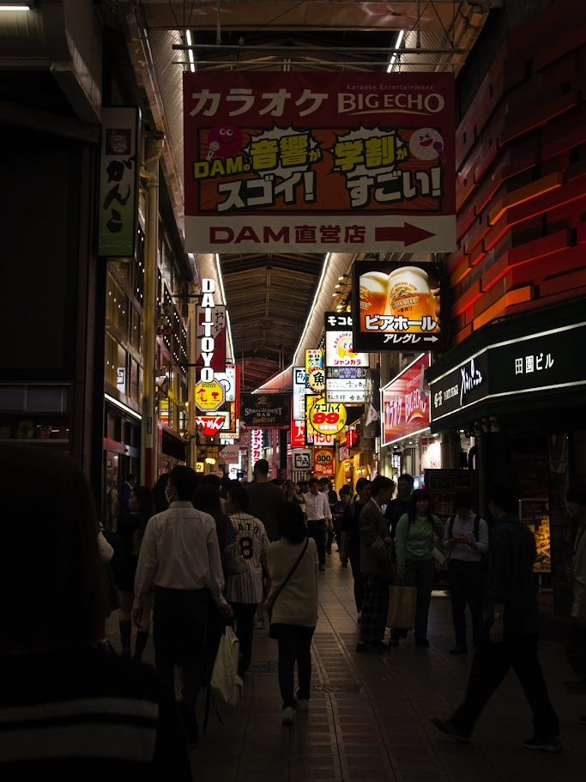
Street Photography
Captures candid moments of everyday life in public spaces.

Slide 8
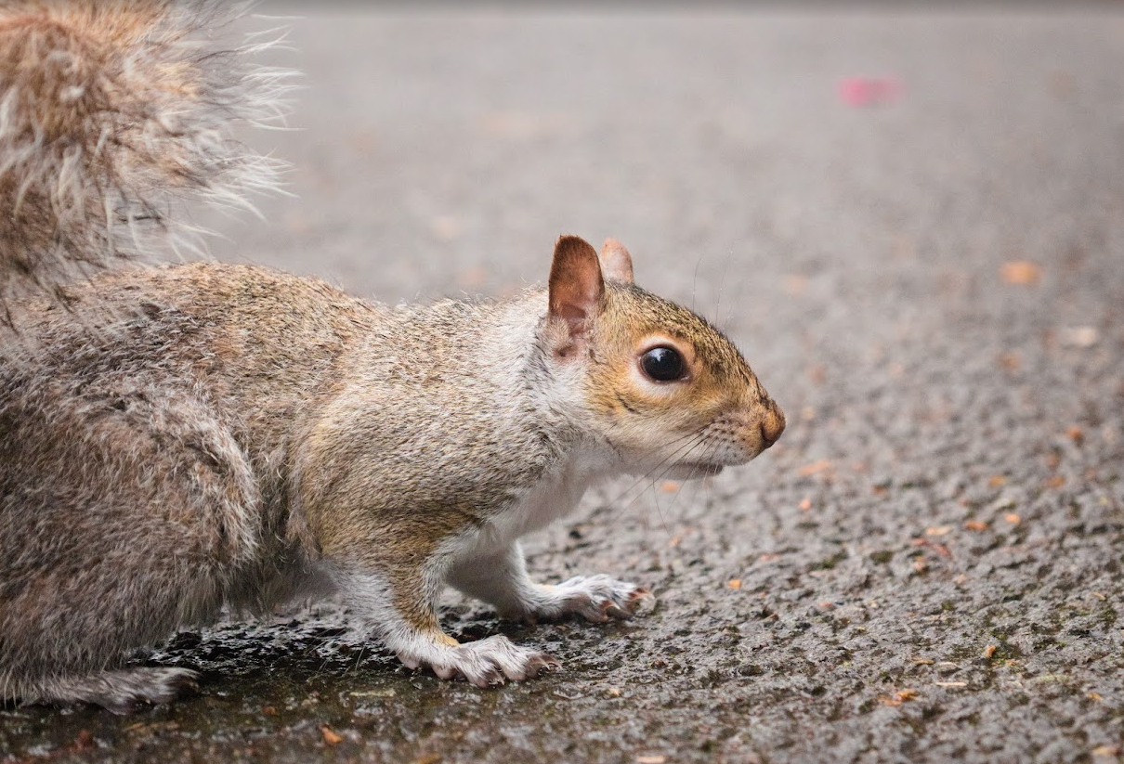
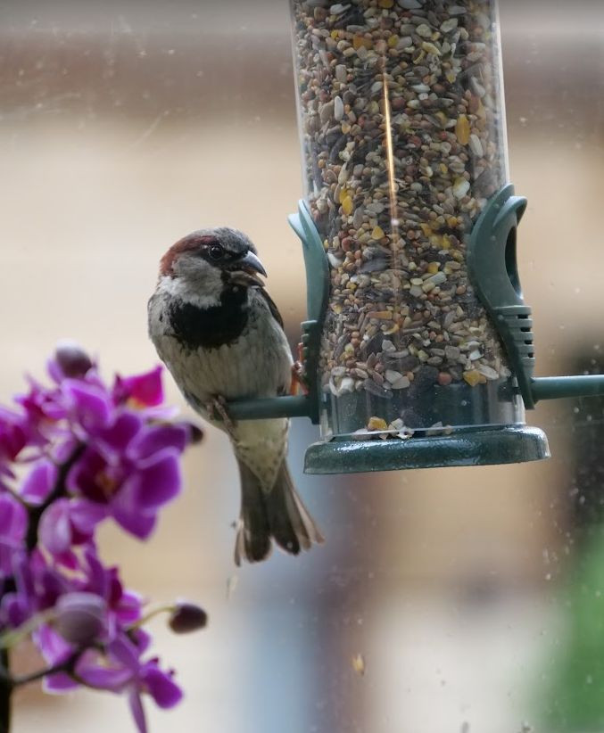
Wildlife Photography
Dedicated to photographing animals in their natural habitats.

Slide 9
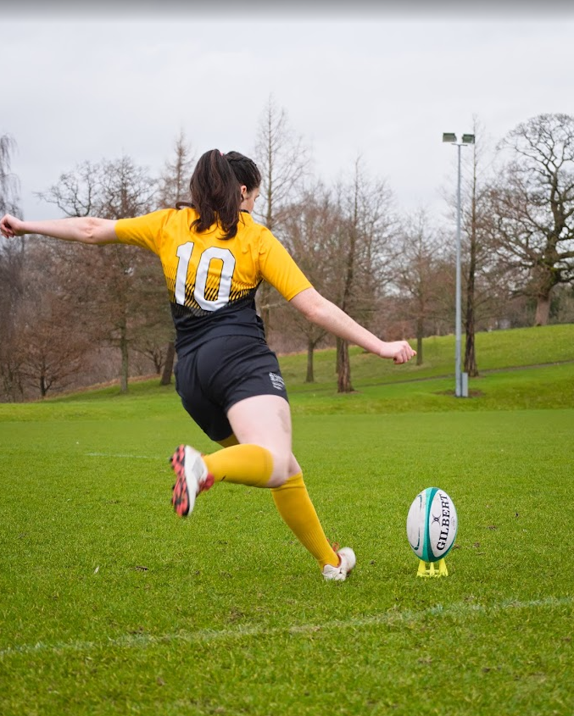
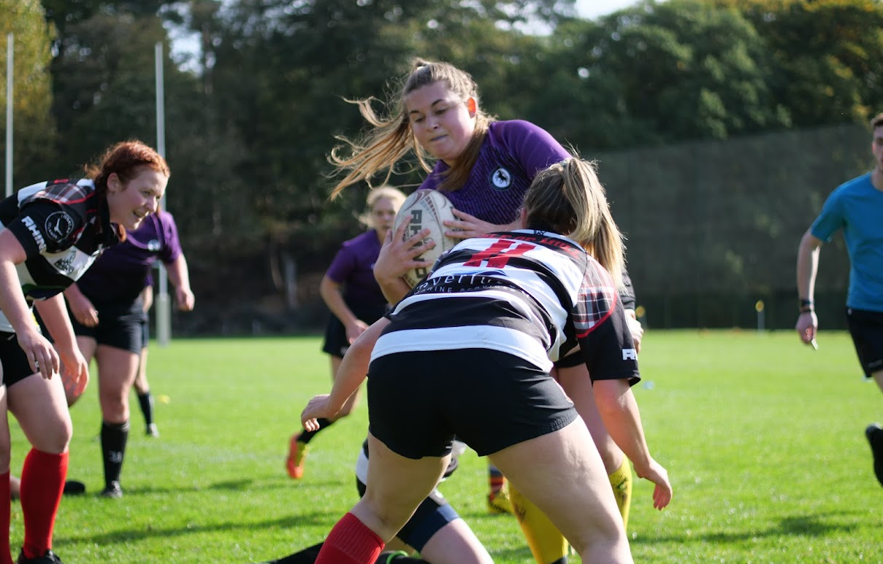
Sports Photography
Captures the action and excitement of sporting events.

Slide 10
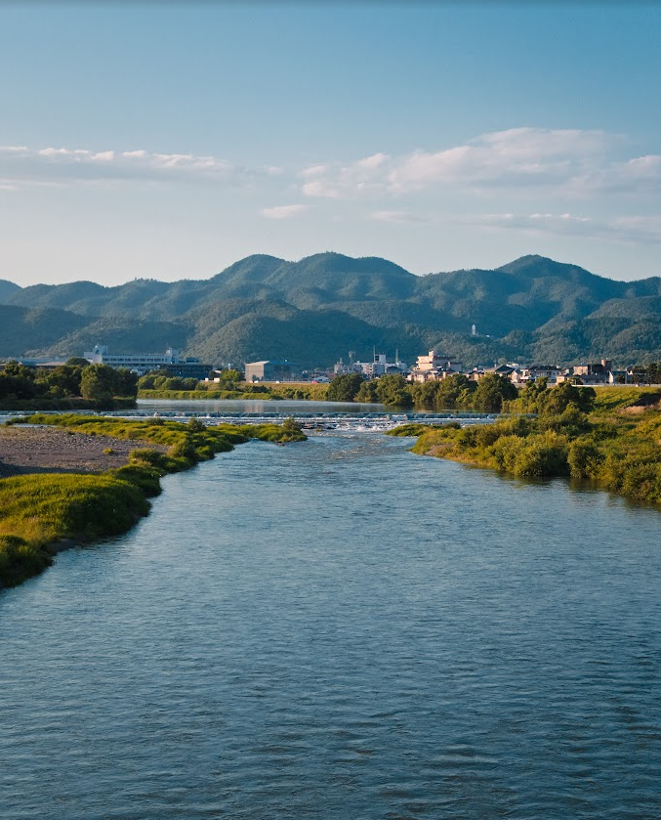
Other Genres
A few more genres:
Fashion
Firework
Still life
Wedding
Aerial
Black and White
Advertising
Night
Soft focus
Macro
Panoramic
Underwater

Slide 11
Presentation
Your task today is to research at least 3 different photography genres:
What are the subjects of the genres?
What are the challenges in capturing those types of photo?
Find examples of each genre

Slide 12
Learning intentions and success criteria
I am learning…
I can…
About different photography genres
How to describe photography genres
Identify and define different photography genres
Create a presentation about different photography genres

